Slide 1
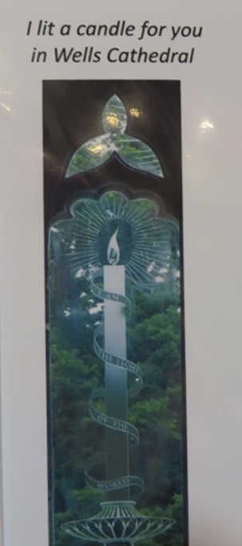
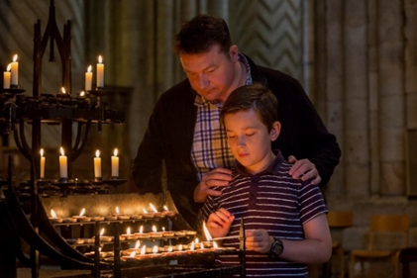
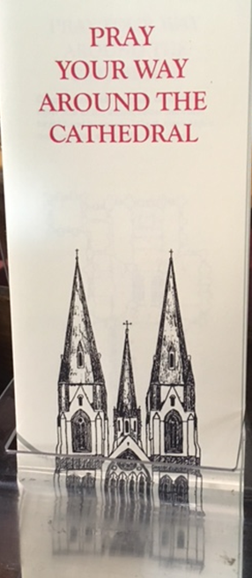
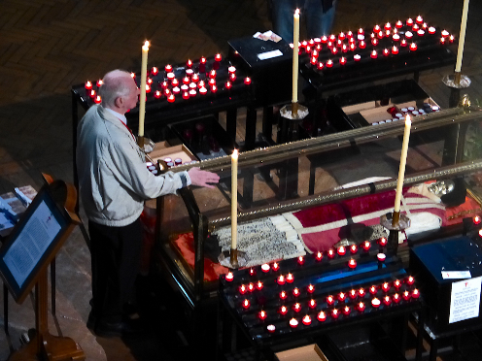

Contemporary perspectives: understanding and supporting visitor engagement today
Dr Marion Bowman & Professor Simon Coleman
Cat
Cathedrals, Mission and the Power of ‘Place’
Past, Present and Future
Lambeth Palace
November 2017

Slide 2
Three themes to explore:
Contemporary perspectives: particularly the cathedrals’ multiple roles as liturgical, administrative, urban, and heritage centres
How ‘understanding’ leads to ‘supporting’: the inductive method
What is meant by ‘engagement’? Where, when, how, who?

Slide 3
Three contexts: No. 1: Popularity
Simon Curtis (2016): ‘Against…broader decline [of parish churches]…England’s cathedrals have seen a recovery in attendance, which became especially marked from the mid 1990s and has continued to the present day.’
‘Spiritual Capital: The Present and Future of English Cathedrals’ (2012): over a quarter (27%) of England’s adult population state that they have been to a Church of England cathedral within the last 12 months.
Andrew Nunn, Dean of Southwark (Premier's News Hour, 9 November 2017): ‘There is something around the accessibility of cathedrals….It's the fact that we're open all the time so that people come in on their own time.’
John Inge, Bishop of Worcester: ‘Behind these figures lie stories of worship, learning, exploring faith and spirituality and encountering God at times of joy and despair.’

Slide 4
Context 2: Visibility
Judith Muskett’s (2015): ‘shop window’
Cathedrals as the shop window for a spiritual presence in a place
(from Judith Muskett and Leslie J. Francis “Shaping Cathedral Studies: A Scientific Approach” in Anglican Cathedrals in Modern Life edited by Leslie J. Francis)

Slide 5
Context 3: Connection: ‘Spiritual Capital’
‘…to connect spiritually with those who are on or beyond the Christian “periphery,”’ given that ‘cathedrals have a seminal role as a source of what is known as “bridging” social capital, establishing and fostering the relationships between disparate and different groups within a community’ (p. 12).

Slide 6
Context 3: Connection: ‘Spiritual Capital’
‘Because…the established Church, has long been (understood as) an institution with clear and confirmed views on spiritual issues, it does not naturally inhabit the more liminal spiritual space that ever more people are occupying. While not necessarily unique in their position, cathedrals are an important exception to this—clearly and distinctly perceived as Christian, and as institutions, but at the same time understood as open spaces of spiritual possibility [italics and bold in the original] in which exploration and development of emergent spiritualities are made possible.’

Slide 7
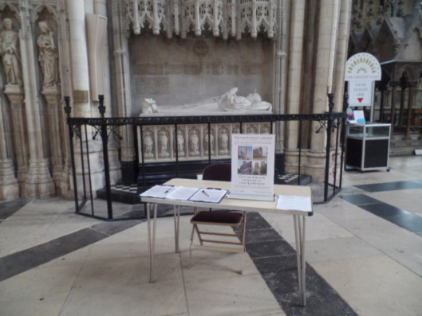
Methods used to gather data
Questionnaires
Semi-structured interviews
Email interviews
Participant Observation/’Hanging Out’

Slide 8
What People Are Doing, Seeking and Experiencing

Slide 9
A Note on the ‘Nones’
People of notionally ‘No Religion’ (blue on graph) were lighting candles, praying, watching others take part in services, etc
The ‘nones’ - people self-identifying as ‘no religion’ - are growing in number but ‘no religion’ often means no institutional religious affiliation, it doesn’t mean not religious.
People notionally of ‘no religion’ might be inspired by a number of traditions simultaneously, pursuing a variety of spiritual practices, or spiritually seeking.
These are the people increasingly likely to be found on pilgrimage (such as the Camino to Santiago de Compostela) and visiting Cathedrals.

Slide 11
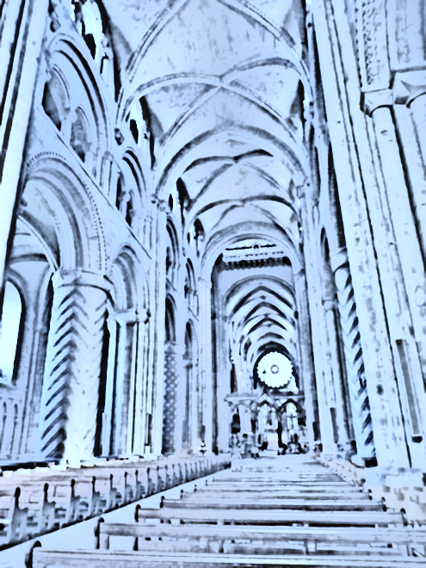
Free text quotations from questionnaires
‘Thought about my life; the significance of other people's contribution’
‘Walked around enjoying the PEACE, the mosaics and organ music’
‘Wrote a card for the Christmas tree and prayed for Palestine’
‘Sat to reflect on those most dear to me, dead and alive’
‘Gazed at the Anthony Gormley figure – just amazing’
‘Listened to the organ practice’
‘Admired architecture’
‘Took photos, sat in peace for a while’
‘Looked at the beautiful building’
‘Meditated’
‘Spoke to someone about the meaning of life’

Slide 13
‘In the same vein that the pilgrim wants to see, touch, and experience the actual objects and places associated with saints and miracles, the tourist is attracted to phenomena and places perceived as genuine and charged with an aura of uniqueness.’
Susanne Österlund-Pötzsch: ‘The Tourist Gait – walking tactics home and away’, p2 [http://begivenhedskultur.dk/_events/2009/motion_emotion/proceedings/Oesterlund-Poetzsch.pdf]

Slide 14
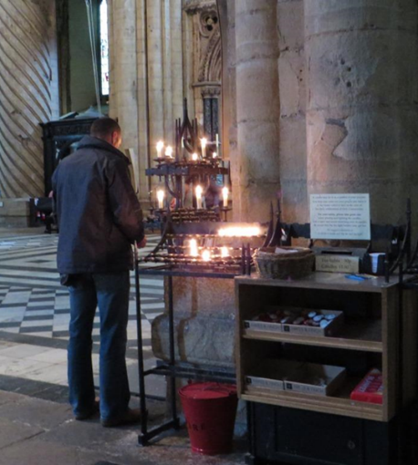
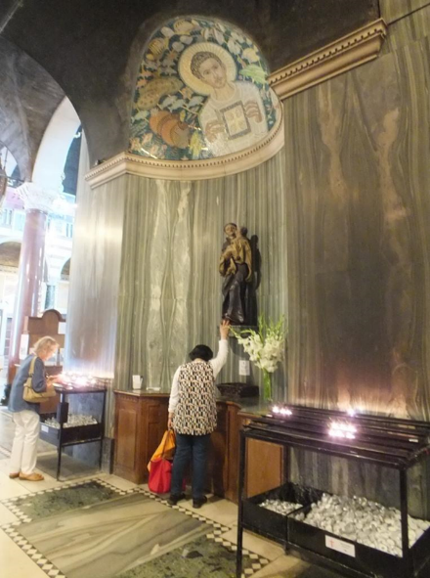
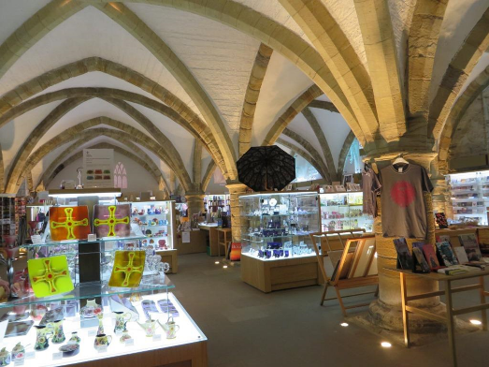
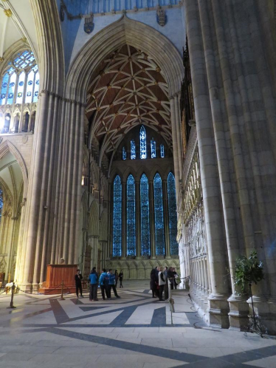
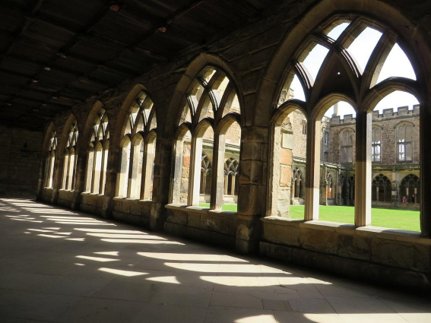
Cathedrals As Multivalent Spaces
Durham shop (above left ) and nave (above right)
Canterbury cloisters (below)
Westminster (above)
York (right)

Slide 15
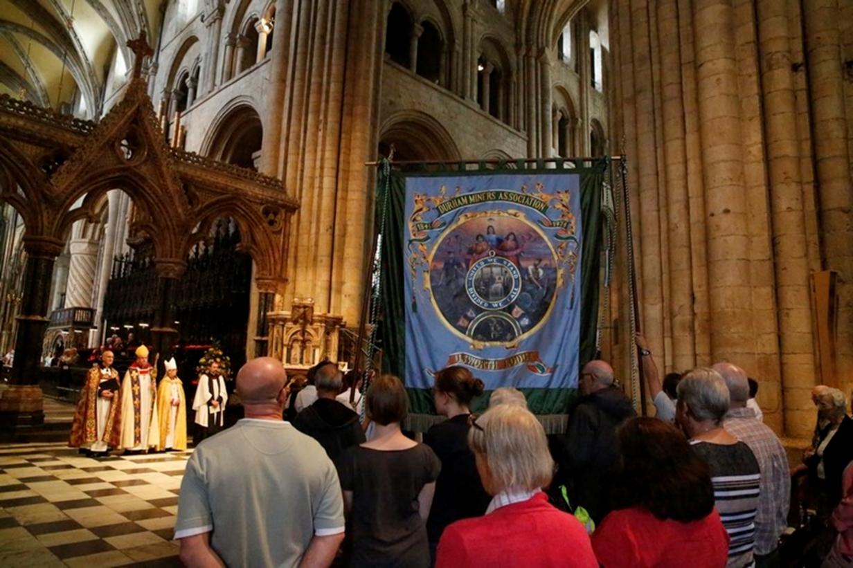
Cathedrals as places of low thresholds, but high expectations. http://www.durhamps.co.uk/wp-content/uploads/2016/06/20150711-1172-w.jpg
Durham Miners Gala

Slide 16
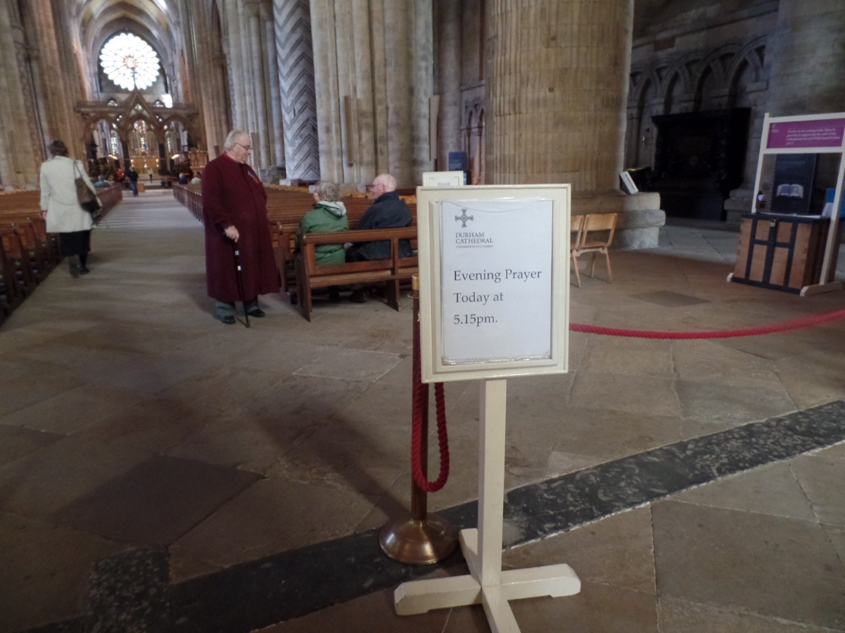
Cathedrals as spaces with codes of access and behaviour

Slide 17
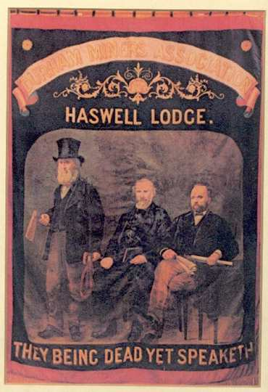
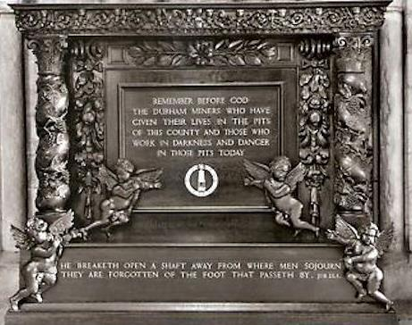
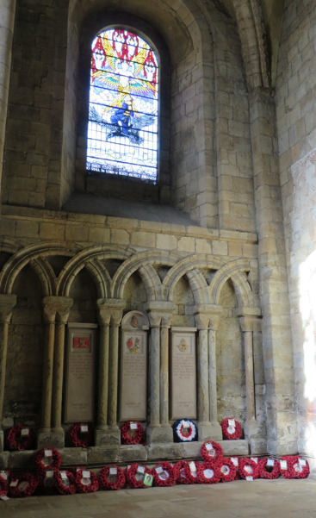
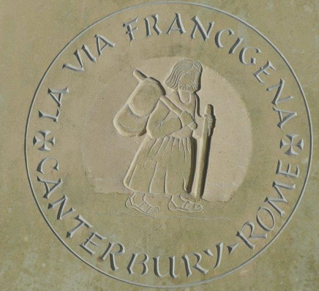
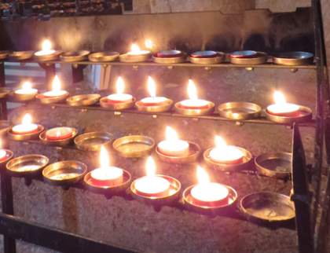
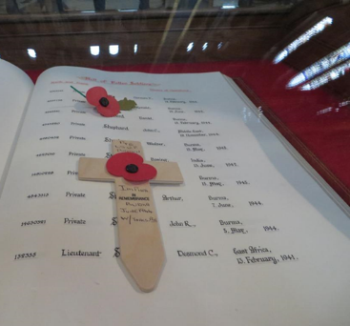
Cathedrals as spaces of Relationality

Slide 18
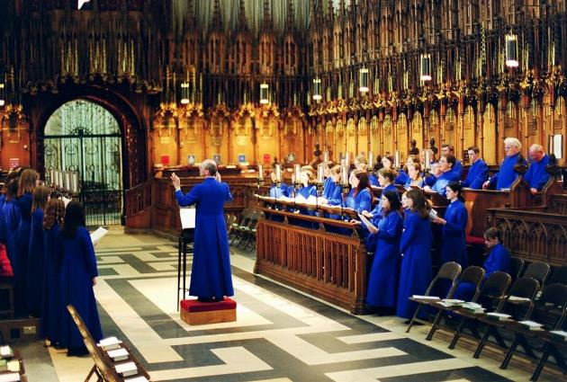
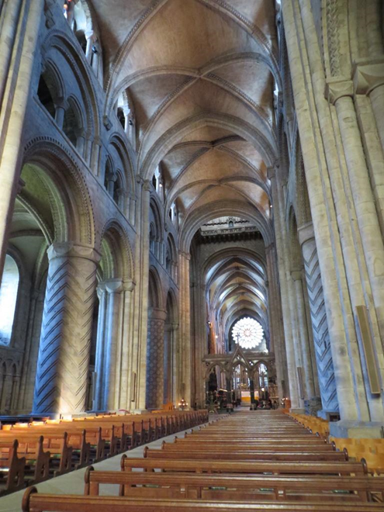

Cathedrals as Shape-shifters
- the importance of adjacency

Slide 19
Karen Franck and Quentin Stevens (2007)
‘Loose’ vs ‘Tight’ spaces‘
From Loose Space: Possibility and Diversity in Urban Life (2007)

Slide 20
Franck and Stevens on ‘Loose Space’ (2007: 3)
‘Here is the breathing space of city life, offering opportunities for exploration and discovery, for the unexpected, the unregulated, the spontaneous and the risky.’

Slide 21
Forms of ‘Openness’ which cathedrals offer
Spiritual Capital Report: ‘open spaces of spiritual possibility’
Andrew Nunn: ‘something around the accessibility of cathedrals’ as part of their attraction
Franck and Stevens: ‘opportunities for exploration and discovery’

Slide 22
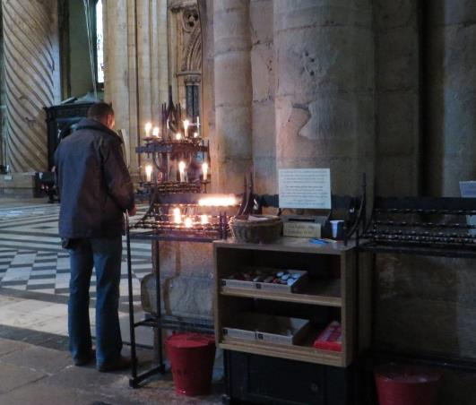

Loose Spaces where activity is less regulated

Slide 23
Quote from a Volunteer about the creation of a ‘tight’ space
‘And that rope business in general. Several people have asked why the ropes go up already 30 minutes before the service, thus blocking the way to the Feretory. Some question the use for ropes at all: Why not let everybody in during the service so that they can see there are no magic rituals going on?’

Slide 24
Rope as a way of creating ‘Tightness’
Often temporary – enable the flexible choreography of the cathedral
Allows one to view ‘other’ space, but not enter it
Often visibly operated by verger/sacristan/volunteer
Boundary-object that both reinforces exclusion (produces ‘tightness’) and suggests the possibility of its removal (relaxation into ‘looseness’)
Requires specific knowledge and authority for its operation

Slide 25
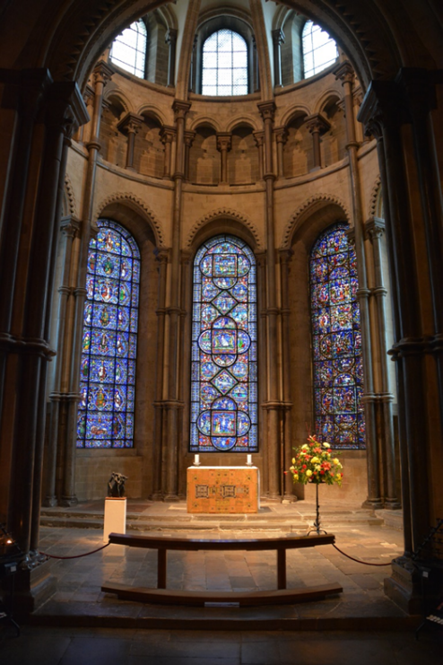
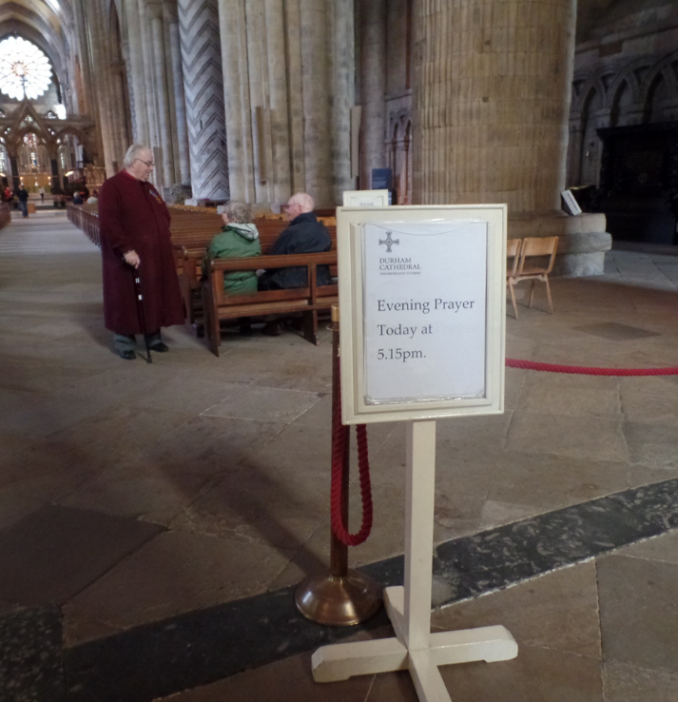
Ropes

Slide 26
Candle as means of engagement often productive of looseness
Part of both formal liturgy and less formal spaces around cathedral
Used in both public and private contexts of action
Visibly ‘operated’ by visitors
Both commercial and non-commercial object
Like rope, can be placed almost anywhere
Unlike rope, non-permanent: engages in its own destruction/disappearance through being used
Does not require specific knowledge for operation (used by visitors as well as clergy and volunteers): part of both tight and loose operation of space, and contexts that are ambiguously in between

Slide 27
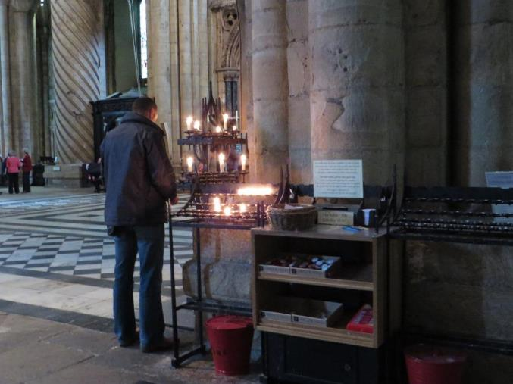
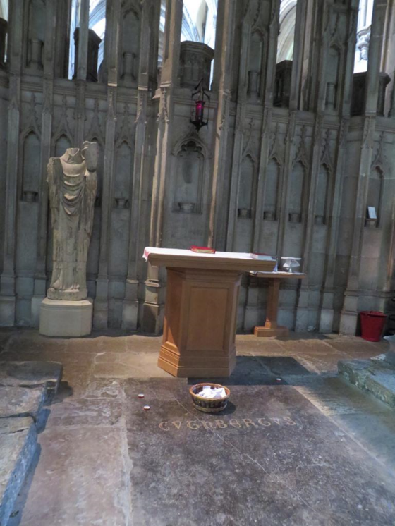
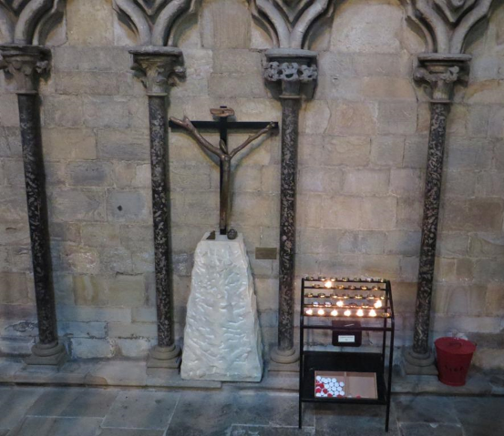
Examples of Loose Spaces created by candle-lighting and the chance to leave prayers

Slide 28
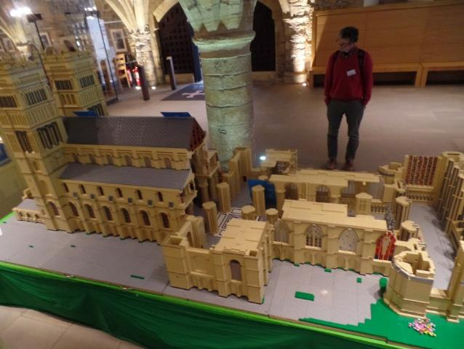
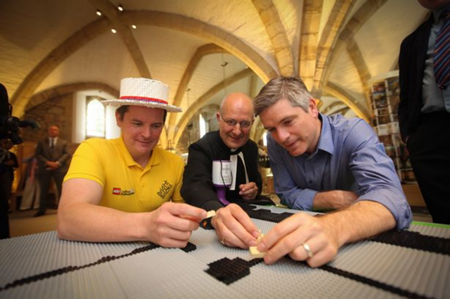
Lego as Means of Engagement

Slide 29
Responses to Lego (unedited)
Love the fact my children played a part in this instillation
I am so glad that our family was able to work there
Placed bricks when the project first began on the first level, foundation builder haha
This is awsome pleased I was a part
Glad I made a brick donation

Slide 30

ENGAGING WITH CATHEDRALS

Slide 31
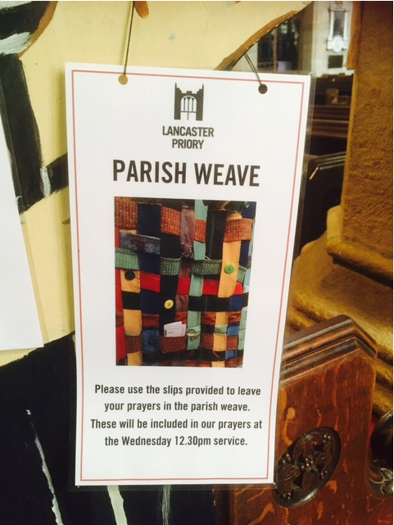
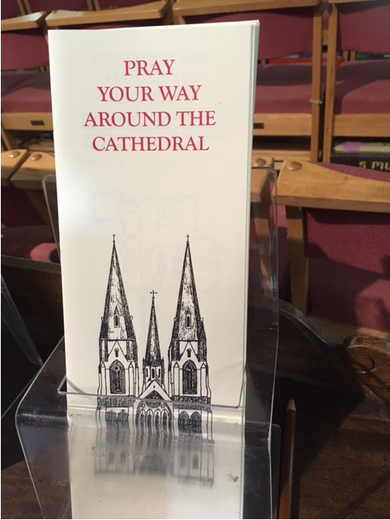
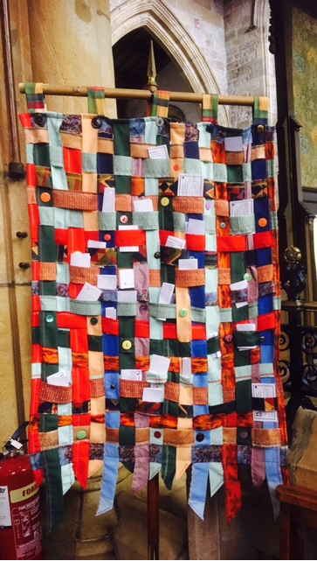

Slide 32
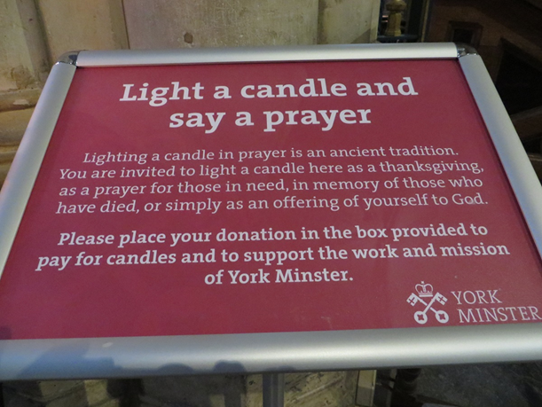


Slide 33
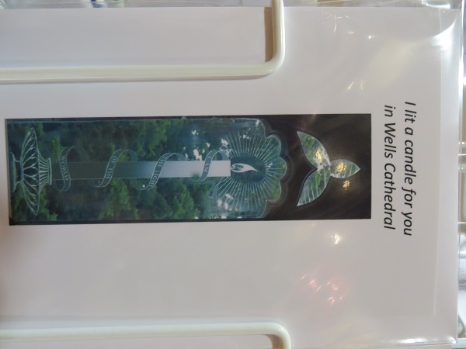
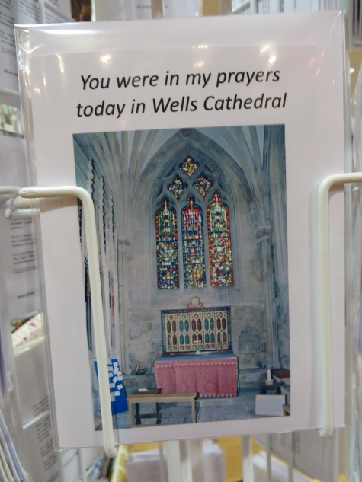
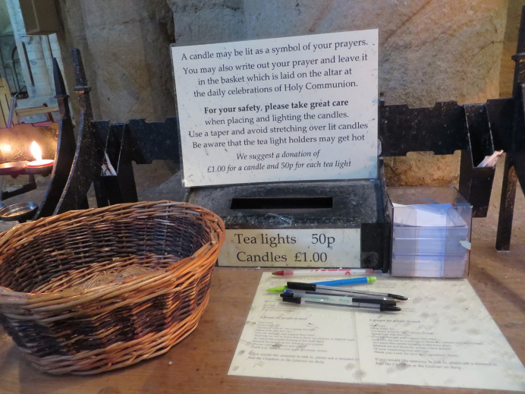

Slide 34
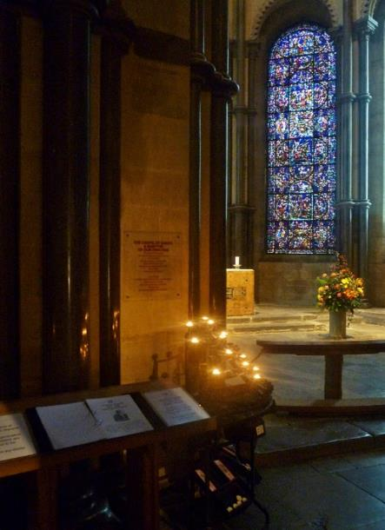
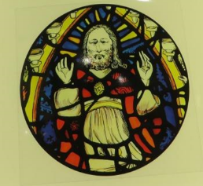
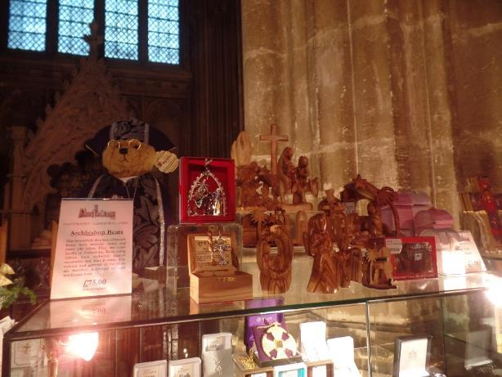
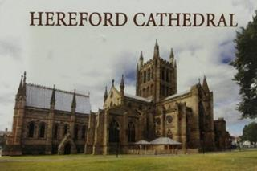
Quotes about leaving and taking away
“People have poured out their hearts…their lives and their spirituality into the building… leaving their mark in the form of a candle or a prayer... It could just be just a stone building but it has the daily flow going through and everything has a meaning, and everything has a beauty behind it. It’s like a tapestry, a carpet of stories.”
“[Purchasing items in the Cathedral] ‘will definitely make them more special to me because of where I bought them”

Slide 35
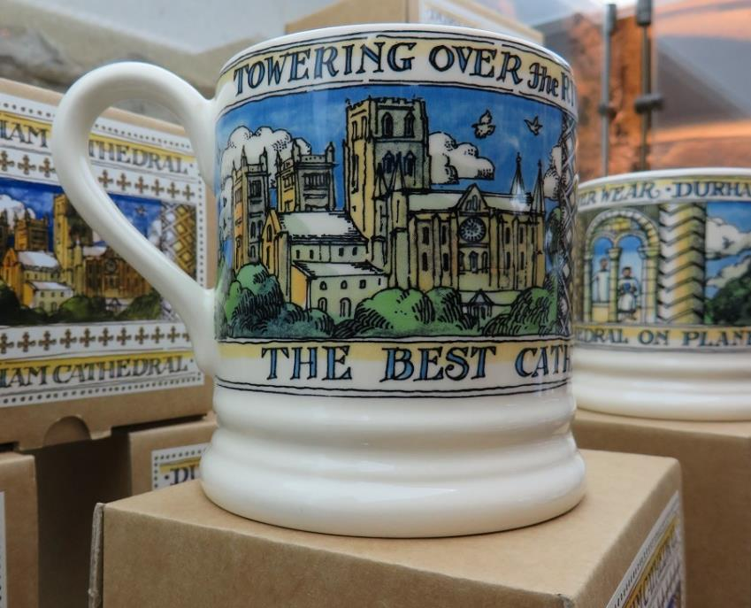
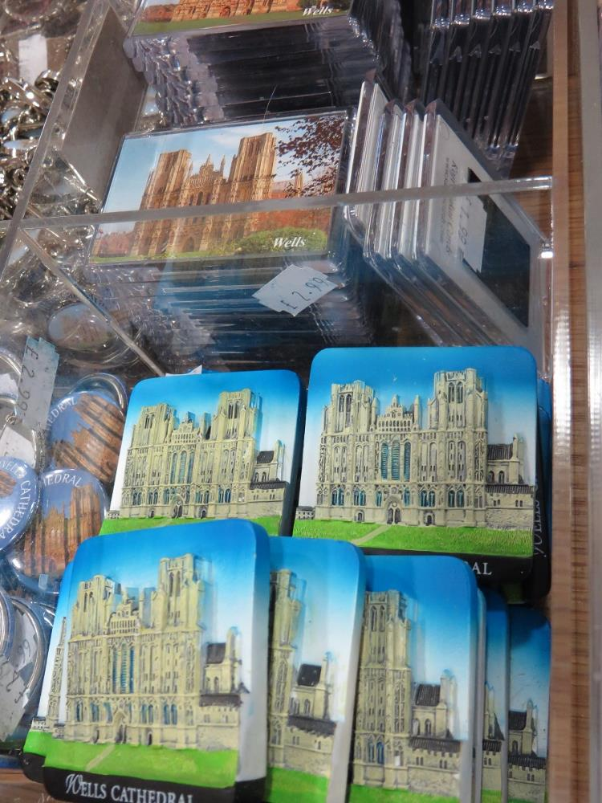
The importance of where an item is bought and whether or not it shows the building – the fridge magnet as aide memoire and the modern equivalent of a medieval pilgrim badge!

Slide 36
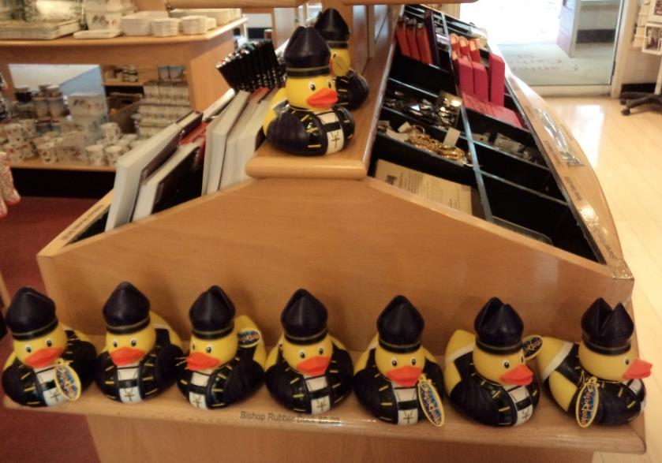
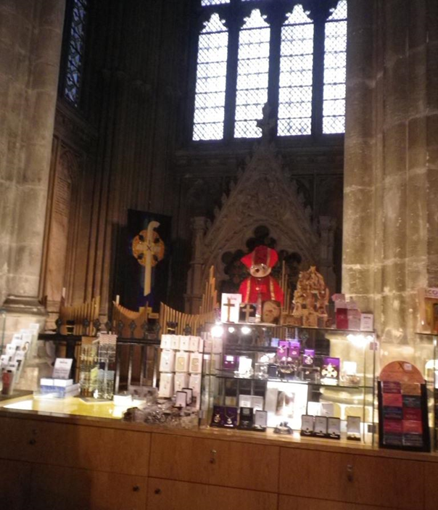

Slide 37
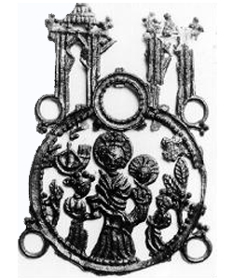
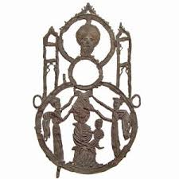

Slide 38
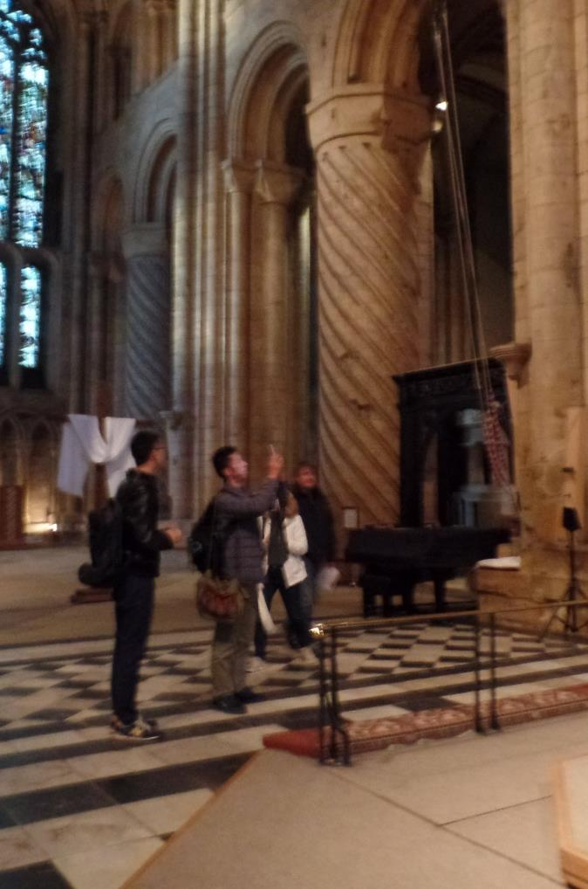
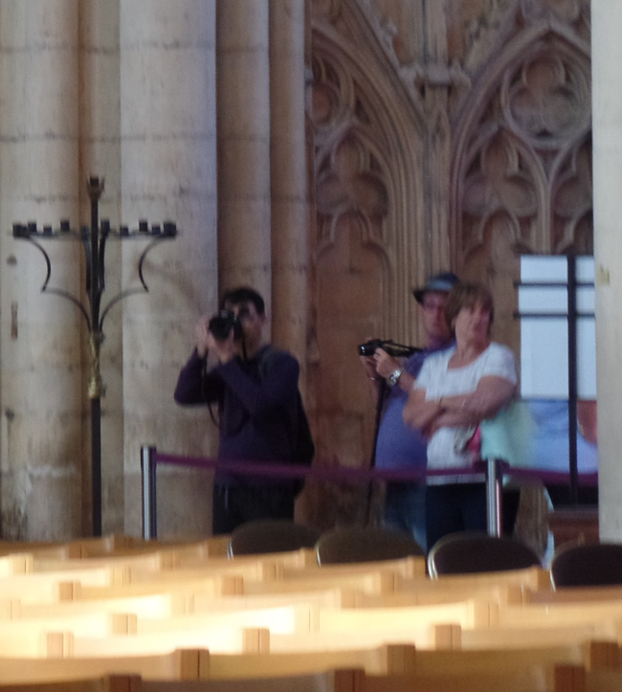
The significance to visitors of photography, especially the potency of the selfie – not just recording but validating experiences

Slide 39
Pilgrimage Experience Days
Westminster: two trails
Durham trail and guide
Focus on 17th century martyr St John Southworth and his story
Relating his life and example to the art and architecture of the cathedral
An adults’ prayer trail and a Children’s pilgrimage trail
Both had chance to light candles
Self-directed trail around the cathedral, with reflections/points to ponder
Option to go on a guided walk with prayers and more spiritual focus
Offered a cockle shell to take home or leave at the feretory

Slide 40
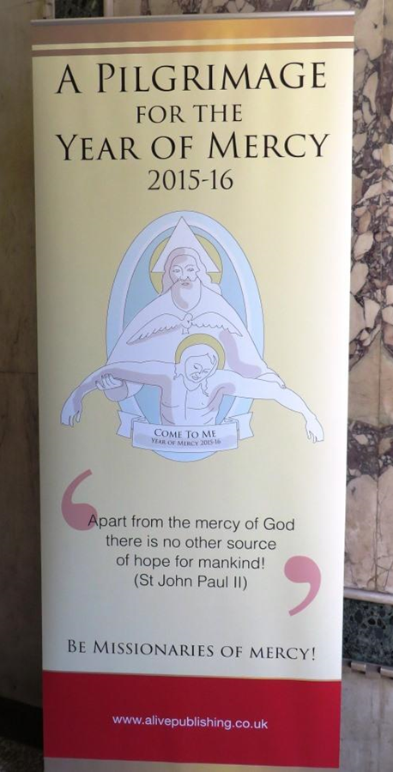
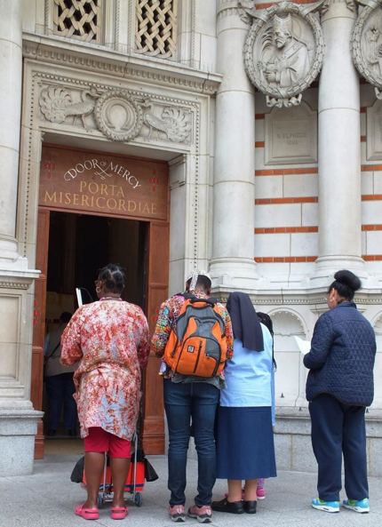

The importance of the Year of Mercy in how people perceived Westminster Cathedral, and how they saw themselves

Slide 41




Slide 43
Pilgrim/tourist: not either/or - can be both/and with movement along a continuum
Cathedrals contain tight and loose spaces: Loose spaces can be significant
The significance of adjacencies and access: the ways cathedrals house different activities, often simultaneously, within close proximity. Fuzzy boundaries can be potent!
Spaces of relationality: Cathedrals are places where people may seek anonymity, but may also seek connections with other visitors, faith, history, their city, etc. Sometimes, connections made are unexpected
Invitations to engage: People need creative but unthreatening pathways into engagement, and safe, welcoming spaces.
Taking away: Items acquired at Cathedrals have significance. Photographs both mark an individual’s presence at the place, and provide an ongoing memory/connection. The photo of a candle lit for somebody else can be a powerful testimony and gift, mediated by both candle and photo, especially in the era of social media.

Slide 44
SHAPE SHIFTING
Who are the shape shifters? Who influences and responds to spaces?
Deans and Chapters
Vergers and Sacristans
Volunteers
Visitors

